Slide 1

Multi-Agent AI Framework for Automated Software Development
AI Framework for Automated Software Development
Team Members:
2420030444 – Suhitha Chalasani
2420030398 – Kapilavai Hamsini
2420030472 – Sri Raaga Tangirala
Cluster – 2, Section 7

Slide 2
PROBLEM STATEMENT
Traditional SDLC is manual and slow across requirements, design, coding, testing, and documentation.
A single LLM can't handle a full project end-to-end — too much breadth and complexity.
Tools like ChatDev, MetaGPT, and AgentCoder generate isolated snippets, not complete multi-file projects.
Need: a system that takes one requirement and carries it through planning, coding, review, testing (with retries), and documentation on its own.

Slide 3
OBJECTIVES
Build a 4-agent pipeline — Planner, Coder, Tester, Reviewer — each owning one SDLC.
Use LangGraph to sequence agents, share state, and manage retries.
Keep one shared state object (spec, code, test results, review verdicts, retry counts) so agents don't lose context.
Use Groq's gpt-oss-120b (Planner/Reviewer) and gpt-oss-20b (Coder/Tester) — fast, free-tier, no GPU needed.
On test/review failure, loop back to the Coder automatically, capped by a retry limit.

Slide 4
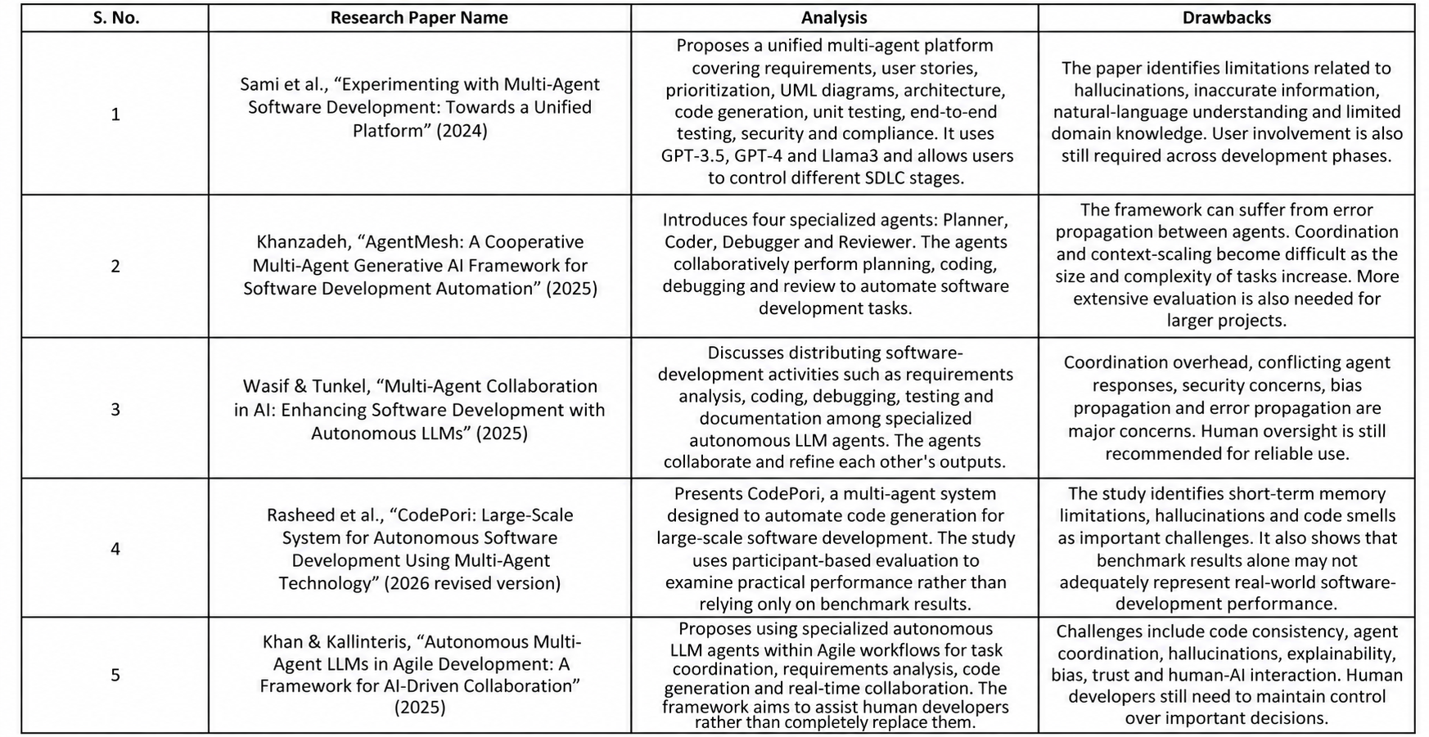
Literature Survey

Slide 5
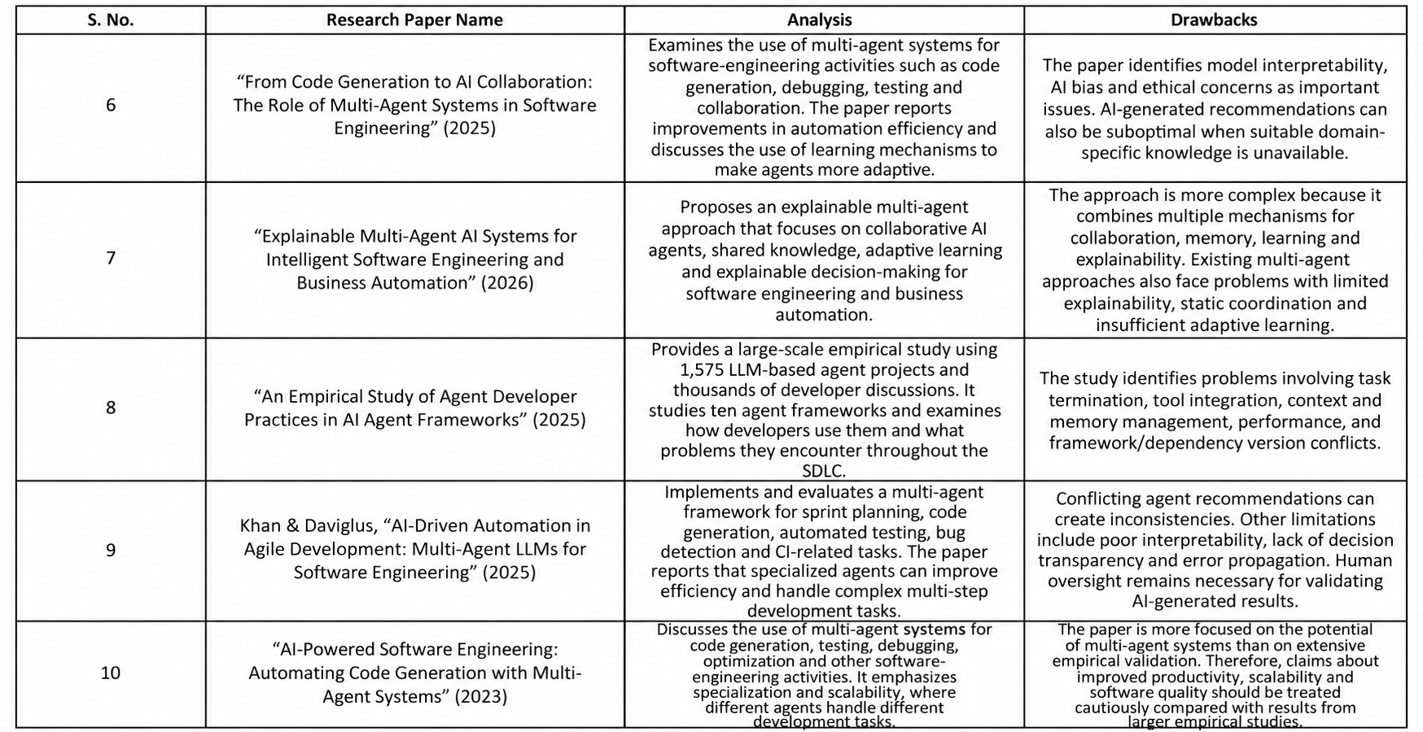
Literature Survey

Slide 6
RESEARCH GAPS IDENTIFICATION
ChatDev/MetaGPT/AgentCoder produce isolated functions, not full projects with a real test-to-code feedback loop.
CodePori's evaluation found hallucination, cross-file memory loss, and orchestration failures — issues standard benchmarks miss.
AgentMesh has a debugging loop but no orchestrator for multi-file coordination.
Sami et al.'s platform separates requirements/architecture/code well but has no automatic retry loop on test failure.
Most literature relies on paid closed models (GPT-3.5/4, Claude) — leaves room for a fast, low-cost, open-weight approach via Groq.

Slide 7
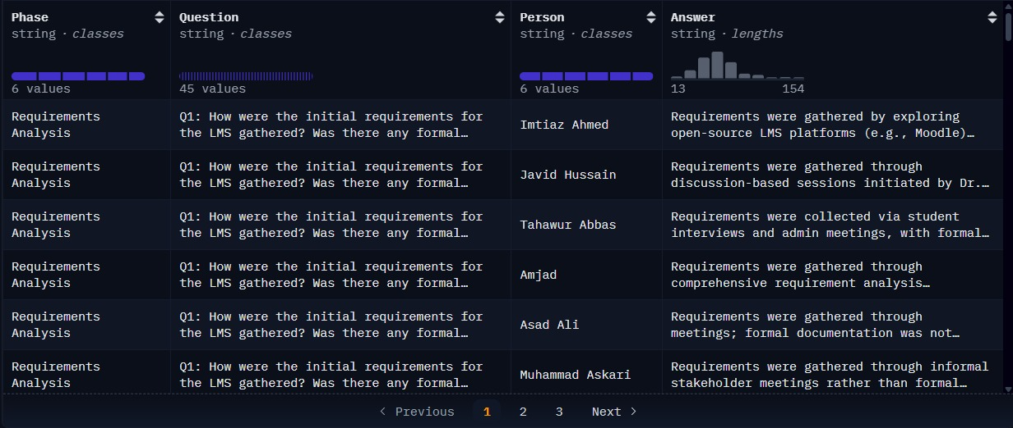
DATASETS
Datasets
HuggingFace | https://huggingface.co/datasets/BasitAliii/sdlc-scenario-based-qa-dataset
Kaggle | ai_multi_agent_interactions_2026.csv
Github | https://github.com/GPT-Laboratory/CodePori_v02

Slide 8
INNOVATION, CREATIVITY & NOVELTY
LangGraph explicitly manages sequencing, state, and retry loops — not a fixed linear pipeline.
Mixed-model routing: gpt-oss-120b for Planner/Reviewer, gpt-oss-20b for Coder/Tester — free-tier vs. paid APIs used elsewhere.
Every agent returns fixed, Pydantic-validated JSON instead of relying on shaky free-tier tool-calling.
Model IDs live in env vars, so swapping providers (already done once after Llama 3.x was deprecated) is a config change, not a code change.
Sandboxed execution closes the safety gap AgentMesh flagged — subprocess isolation + timeout + POSIX resource limits, with three real bugs found and fixed via live runs

Slide 9
FEASIBILITY
Every component (Flask, LangGraph, Groq API, Pydantic, Git) is existing, maintained tech.
Groq's free tier removes the GPU/hosting cost barrier.
Similar pipelines (CodePori, AgentMesh, Sami et al.) already prove this approach works, even if output quality still needs work.
The retry loop is a standard LangGraph conditional edge, not a novel challenge.
Known risks (hallucination, short memory, code smells) are documented, so review/testing stages are planned for them upfront.

Slide 10
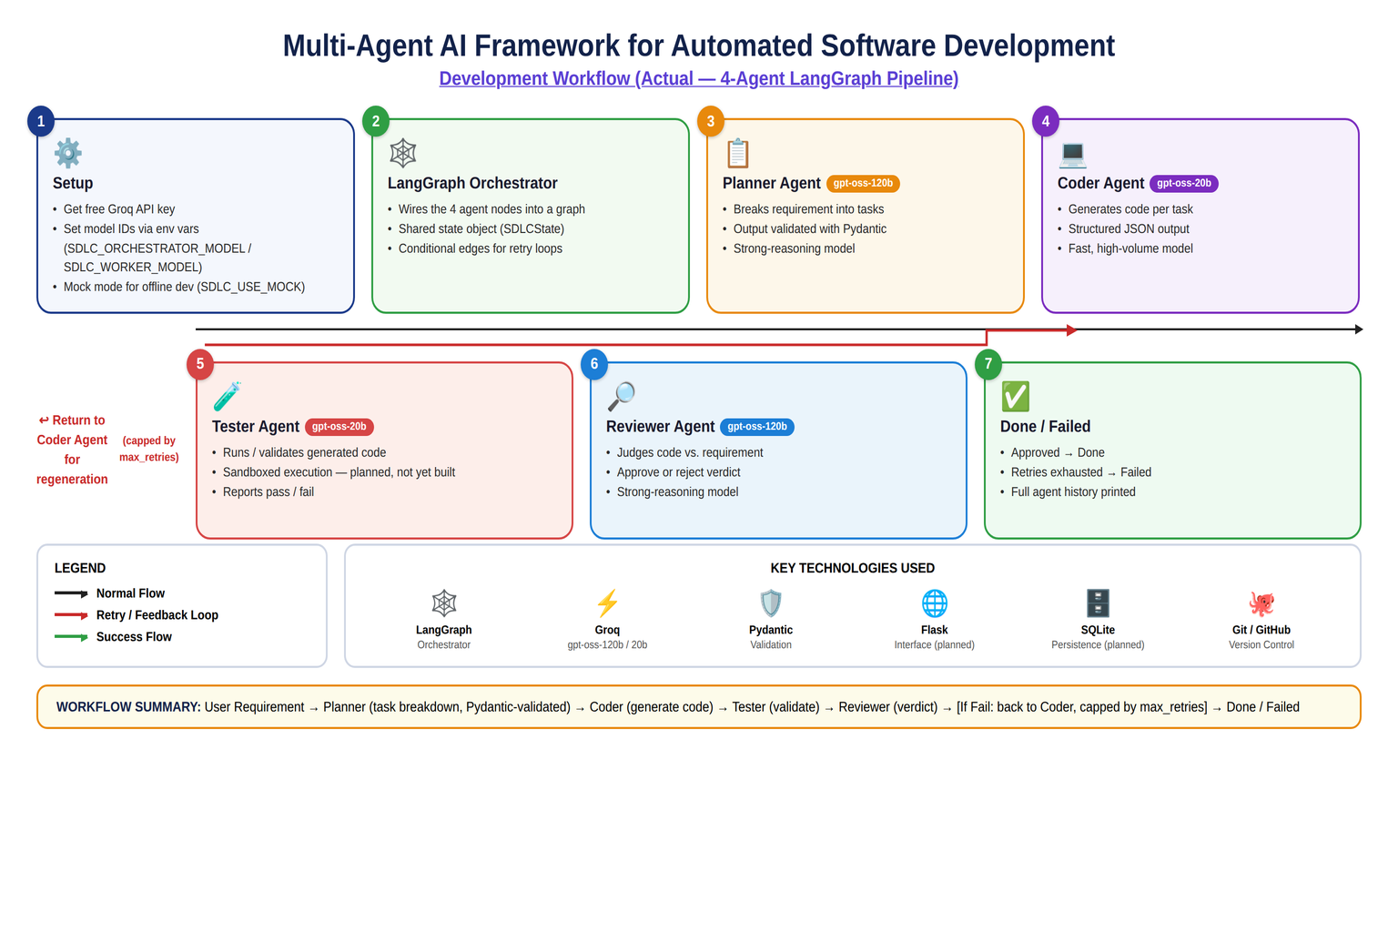
PROJECT PLAN

Slide 11
Thank you

